Slide 1
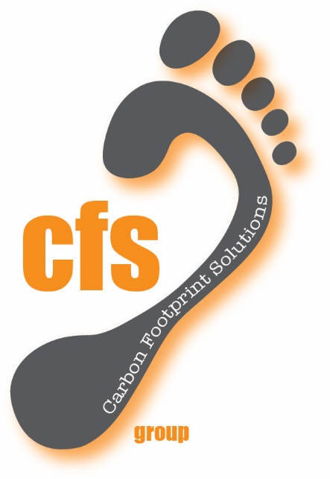
Welcome to
- UNIVAT Pty Ltd
TAILINGS HARVESTER
“ Nailing Your Tailings”

Slide 2
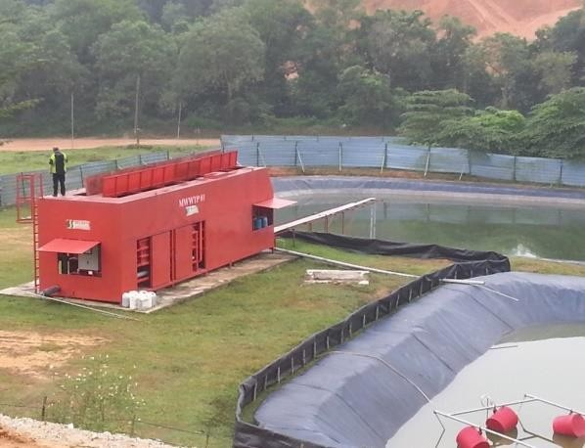
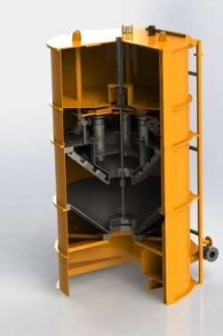
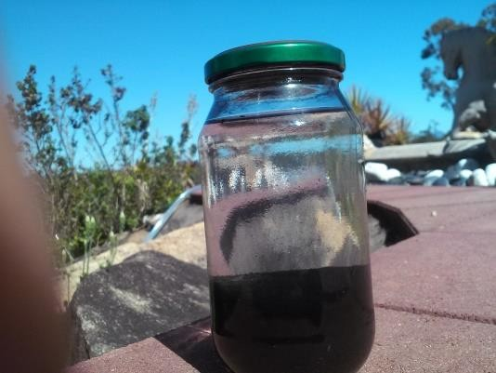
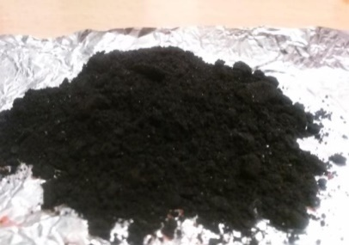


Our Technology separates any Tailings,
Delivering clean water…. and Dry Waste..
IMMEDIATELY

Slide 3

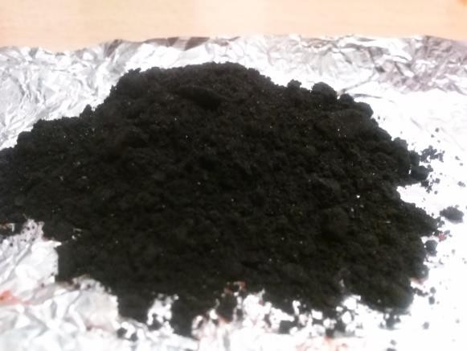
Our own PATENTED SYSTEM
To Do this we use
A Machine (Univat)
An AGENT (Unimix)
A Protocol (Unifix)
1. Liquidised Waste 2. Agent (1:2000
parts)
Machine
PH Balance and
process
Deliver water Back
Value-Add Dry Waste

Slide 4
Our results:
Clean Water
Dry Waste
Other Benefits
Almost No BOD’s
(Biological Oxygen Demand, allows Bio to grow in water)
2. Almost No COD’S
(Chemical Oxygen Demand allows chemical residues to grow in water)
3. Almost No TDS
(Total Dissolved Solids quantify what else is in the water)
4. Almost No Toxicity
5. Can be “Potable” with one extra process.
(*Almost* refers to less than any standards require)
Hydrophobic
( Never likes to be in water anymore)
2. Already Packaged
3. Transportable
4. Value-adding
One Tank Process
Storage Reduction
Re-use of water
Re-purpose of Waste
Environmental
Social
Economical

Slide 5


4 x UNIVAT Process Types
1. Potable
Humanitarian
Remote Villages
Military
Recreation
Resorts
Island Communities
Third World
Disasters
2. Re-usable
Process Plants
Industry
Gas Gathering
Agriculture
Grey Water
Reclamation
De-silting
Space Programs
Shipping (bilges)
3. Reclaimed Waste
Gold Tailings
Ceramics
Coal Fines
Drilling Muds
Dry Storage
Pond Reduction
Process refinement
Environmental Cleanups
4. Repurposed Waste
Industrial Streams
Sewage
Blood and Bone
Carbon and Soot
Red Muds
Fly Ash
Tailings (Copper/gold)
Sugar Mills
Meatworks
etc

Slide 6
POINTS OF DIFFERENCE
UNIMIX (Agent)
100% Natural (Powdered Earth Elements)
NO Chemicals
Multi-Tasking (Can do all waste streams types)
Flocculant and Coagulant - all in one
SPEED and efficiency unmatched
1: 2000 usage ratio (in most cases)
Cost effective (VERY)
UNIVAT (One tank system)
Receives
Mixes
Processes
Separates
Presses
Packages
24V Remote Operable
Satellite Monitoring

Slide 7
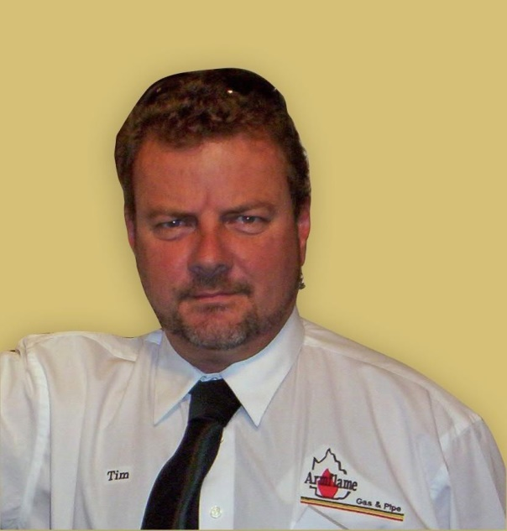
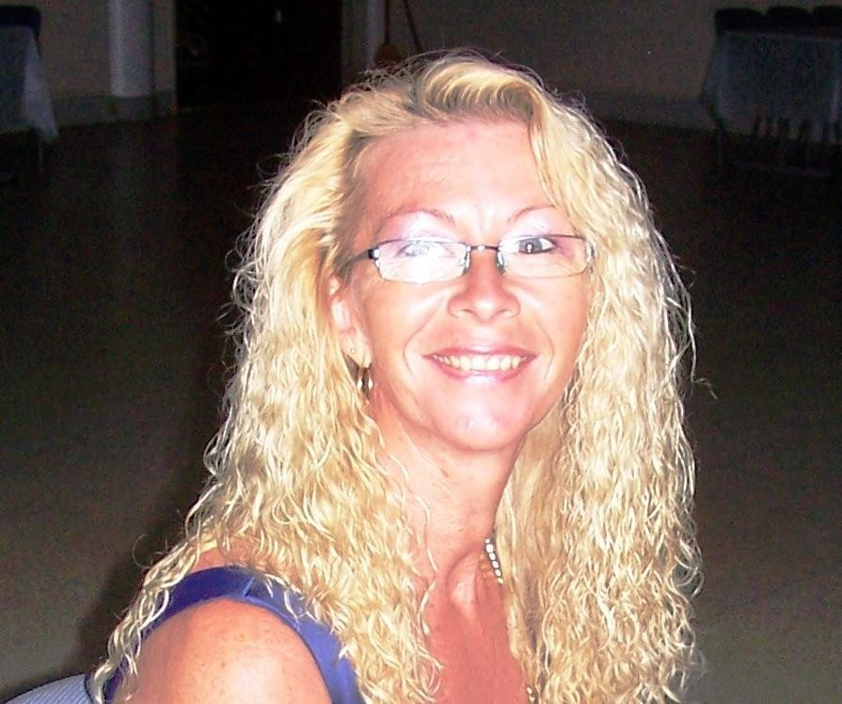
Tim Straatmans
Karen Straatmans
Founder
Co-Founder
Depth of Business Understanding
Founded “ARMFLAME Gas and Pipe” and ran for 21 years – 75 employees- circa 15 Mil t/over
Australian Inventor of Year (2003) – “Coconet” –
Founded “Coconet International” – serviced Qld, Fiji, Malaysia, Singapore
Founded “Industrial Gas Installations” – Merged
Founded “Chop and Chip Tree Lopping” – Merged
Founded “Underline Road Boring” – Merged then Sold
Invented “Univat System” incorporating over 36 awarded patent claims - Current

Slide 8
The Team
(Corporate Advisory)
Corporate Lawyers
IP Lawyers
CPA Accountants
Fabrications Group
Drafting/Design Engineer
Electrical Engineering
Top Tier Resourcing
Filming and Graphics

Slide 9
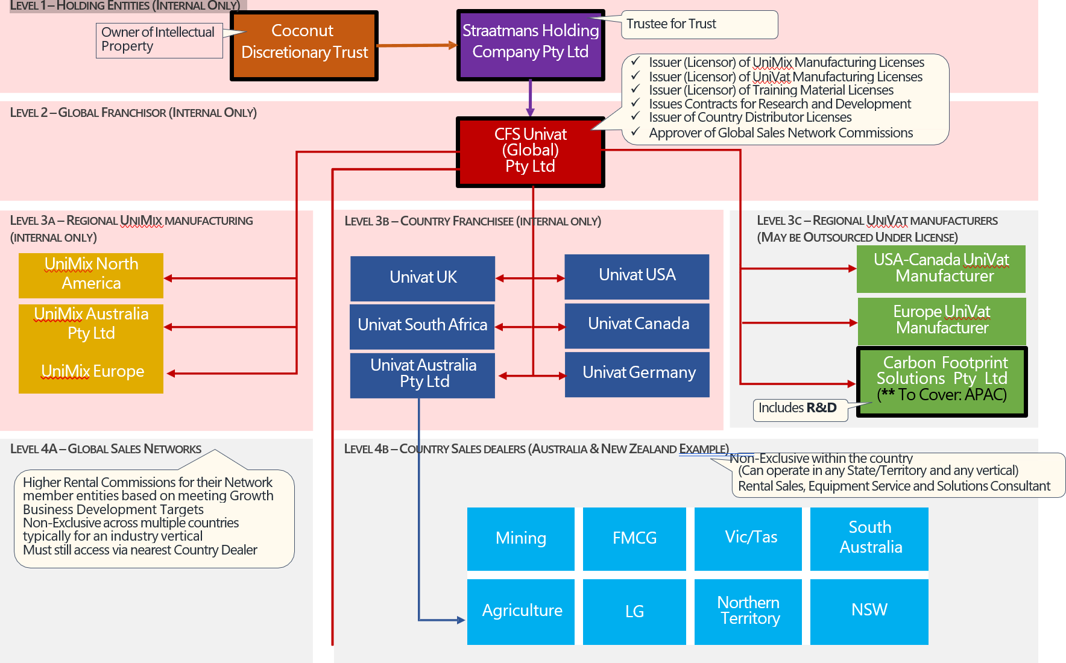
Corporate Structure

Slide 10

UNIVERSITY COLLABORATION
Full suite of R and D (ongoing for scalability)
Design, Engineers, Microbiologists etc
Laboratory Testing and Validations
Corporate/ Industry/ Military Awareness
Media Exposure
Government and Peer Group Exposure
Variable Waste-Stream Testing

Slide 11
PATENTS
Being for the complete SYSTEM
which incorporates;
Process Tank (UniVat)
The Agent (UniMix)
The Protocol (UniFix)
AWARDED
European (EU)
Australia
USA
India
PENDING
Canada
South Africa

Slide 12
CURRENT STATUS (THINGS ALREADY DONE)
Concept
Prototypes
Test Validations
Industry stream tests
Patents (Accepted and Pending)
3D design and modelling
Corporate Team
Business Plan
Pitch Videos and Deck
Company setups
R and D Tax Regd.
Logos, Design, slogans
Expressions of Interests
Collaborations initiated
QUT Collaboration
White papers of cases
A working unit half built
Testing acceptances
Operating LOGIC
Satellite/SCADA concept
21. Safety Mgmt Docs
5 Year Financial Plan
26. 5 Year Cash Flow Plan
Global Rollout Strategy
Breakdowns from Macro
A SEED capital Investor
Commercial Property
Exit Strategy (Trade Sale)
23

Slide 13

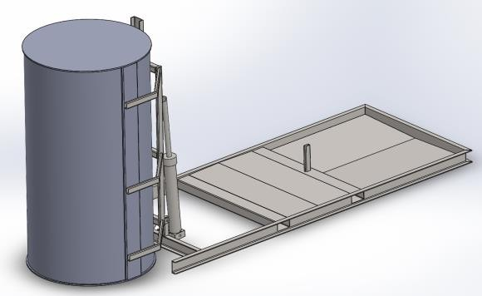
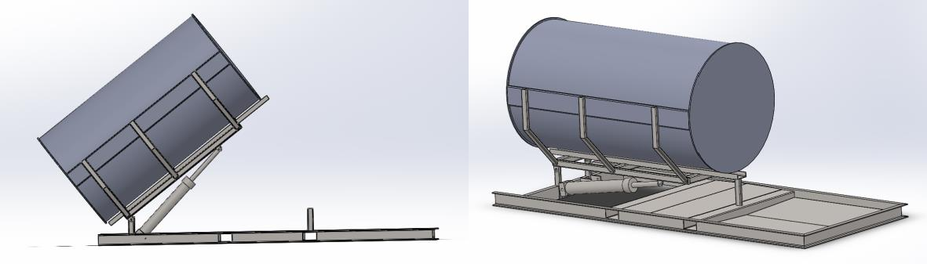
THIS IS MODEL CFSU 07
(TO SUIT OUR TARGET MARKET)
STANDS 3.7 METRES TALL (operating)
PROCESSES 15-20 CU.METRES PER HOUR
LAYS DOWN FOR TRANSPORTATION AND
MAINTENANCE

Slide 14
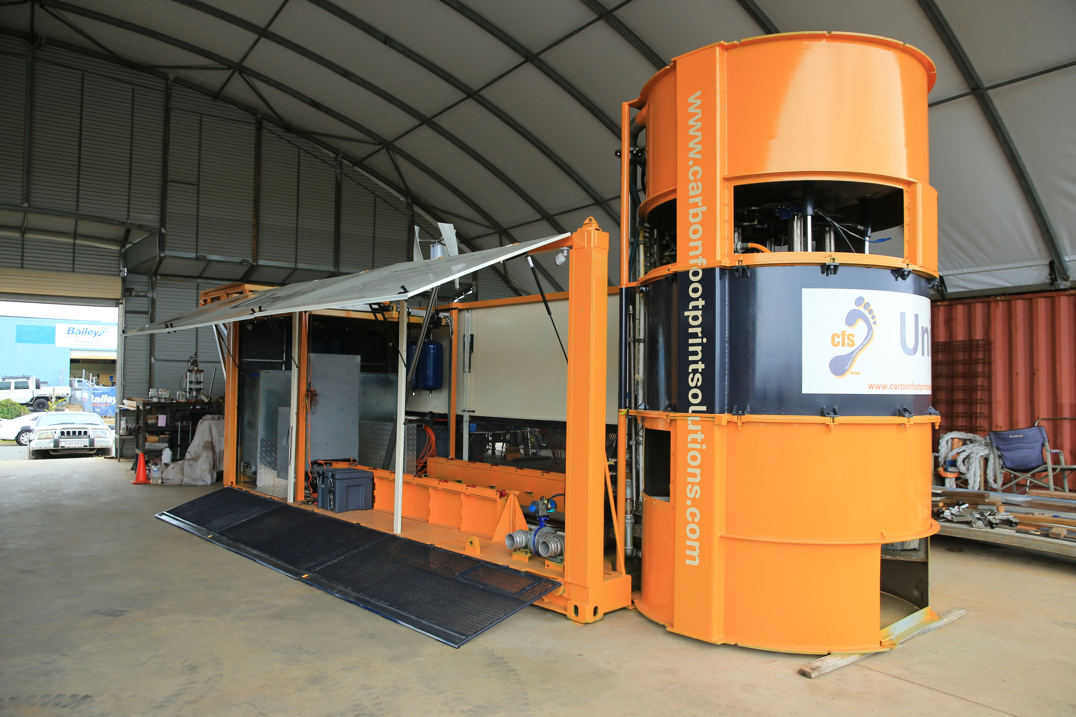
Full scale working UNIVAT near completion

Slide 15
Business - Derived from Several Streams
Remediation Service Business
Lease/Hire of Univat Systems
Licensing
Sales of CFS-Unimix Agent
Environmental Levees
Humanitarian Support
Spin-off Value-added Companies
Spin-off Technologies

Slide 16
3 Year Plan (outline)
Complete Prototype and enter field trials (Local Clients E.G. Rio Tinto, Port Authority etc)
Establish Financial Package to move forward.
Acquire Sizeable Engineering firm (local) (NDA already engaged)
Establish Full workforce for R&D Production. (Gladstone)
Engage in C-Suite Talent Acquisition. (CEO, CFO, COO, HR, Safety, Engineering etc.
Gear up for Mass Production.
Gear up for design and build of Major Batching Plant for CFS-Unimix Blend. (Gladstone)
Acquire and setup full Logistics chain (Shipping Containers, Trucks, Rail, Air)
Acquire Land for full scale 3D production. Design and construct the factory and acquire the 3D machines.
Engage in ever growing workforce, sales, marketing, etc.

Slide 17
“Thankyou for Your Time”
- UNIVAT Pty Ltd
TAILINGS HARVESTER
“ Nailing Your Tailings”

